Slide 1



Tactical Detection Summit
Save the Date: December 4-11 Scottsdale, Arizona
sans.org/summit
SEC599 – Defeating Advanced Adversaries
SEC530 – Defensible Security Architecture
SEC555 – SIEM with Tactical Analytics
SEC511 – Continuous Monitoring & Security Operations
SIEM NetWars
SUMMIT
Dec. 4-5
TRAINING
Dec. 6-11
sans.org/summit
Notes:
Drag Picture and Send to Back

Slide 2
SEC555
Presentation based on SEC555: SIEM with Tactical Analytics
Tactical Application Detection
Justin Henderson (GSE # 108) @SecurityMapper
Tim Garcia (SANS Certified Instructor) @tbg911

Slide 3
Welcome!
A copy of this talk is available at: https://github.com/HASecuritySolutions/presentations
More free stuff: https://github.com/HASecuritySolutions

Slide 4


About Us
Justin Henderson
Author of SEC555: SIEM with Tactical Analytics
GIAC GSE # 108, Cyber Guardian Blue and Red
59 industry certifications (need to get a new hobby)
Tim Garcia
Information Security Engineer
SANS Certified Instructor Cyber Defense curriculum (SEC 301, 401, 501, 511, and 555)

Slide 5
Applications
Applications come in two main flavors
Traditional/Thick Applications - Requires software installed or binaries ran on systems to function
Web Applications - Accessed via web browser
Custom applications often contain large volumes of sensitive data
Web application may report on millions of patients
Thick client may process orders and credit cards

Slide 6

Log Collection
Are we logging?
What is being logged?
How is it being logged?
Where is it being logged to?
How can we get the logs?
Requires a Formal Process and Standardization across the organization

Slide 7
The Problem
Detection capabilities around applications is often lacking
Logging may or may not exist
Web applications may only have web server logs
Application log existence/format subject to will of developer
Log storage can be all over the place
Database
Syslog
Windows Event Log
Flat File (JSON, CSV, XML, W3C, gzip, tar, or many other formats)

Slide 8

Log Collection
Syslog is supported by any SIEM solution
But what about odd files and databases?
NXLog Community Edition works across operating systems
Windows, Mac, Linux, Unix, Android
Supports picking up files and shipping them off
Can collect native operating system logs
Can process CSV, JSON, XML, and other formats

Slide 9
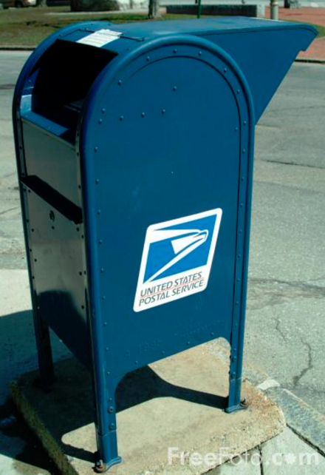
Blind Drop
Windows event forwarding cannot ship file logs
Only handles native Windows events
Business requirement may require no third-party agents
Can be handled by using a blind file share
Requires a single file server to have a third-party agent or PowerShell script
Share is created with write permissions only
Log files are then saved to this share

Slide 10

Logstash
Logstash is technically a log aggregator for Elastic
But its capabilities to handle, parse, and enrich logs is ridiculous
Can work in conjunction with any commercial SIEM
Certain capabilities are perfect for custom applications
JDBC plugin allows pulling logs from databases
Codec support can handle gzip, json, multiline, etc. files
Log can be converted to any format and then shipped off

Slide 11
Special Considerations
Due to the nature of applications these log sources should be considered "in scope"
Bro - Listens promiscuously on network and generates logs
HTTP, SSL, x509, MySQL, and weird logs apply to applications
Web Application Firewalls (WAF) - Inspects/handles all traffic to web applications
Database Activity Monitor (DAM) - Ditto for databases

Slide 12
User Activity Monitoring
Regardless of application type a good log should have
Who, what, when, from where, and maybe to where
"tgarcia at 10.5.55.7 created new user at 4/14/2018 12:04:13"
Who From where What When
This information can be used multiple ways
Logon success/failure monitoring
User profiling
Establishing user clipping levels
Notes:
To where is often used to identify the IP or DNS name of the application or server

Slide 13

Logon Monitoring
Monitoring logon activity is almost universal
Too many failed logons against one user is brute forcing
Password spraying is also common to avoid lock outs
Monitor key users by source
Even if application cannot restrict users to IP addresses
Now if admin user logins from new location you know about it

Slide 14
Detecting Privilege Escalation
How many accounts do users login to an application with?
Do not overthink it - The answer is… one
If > one per source IP, something bad is happening
Application attacks can include bugs that allow an attacker to become another user
Web logs showing rotation of Session ID numbers or fields like uid
Application logs showing multiple users on same IP

Slide 15

Whitelisting or Newly Observed Activity
SIEM also makes it possible to hone in on per user activity
Who does what and does it ever change?
Alert engines can detect users:
Using a new function/task
Through newly observed monitoring
Or via whitelisting user actions
Making large number of requests
Failed or successful - Both are bad

Slide 16
Clipping Levels
To monitor abnormal, clipping levels can be defined
# of logs per user
0 – 199 Info
200 – 299 Notice
300 – 399 Warning
400+ Alert
Evaluate your own clipping levels
# of application transactions
0-99 Info
100 – 149 Notice
150 – 199 Warning
200+ Alert

Slide 17
Web Application Detection
We need to understand what normal is and identify anomalies
The Majority of our applications are web based or migrating to a web application (.NET, JAVA)
We can apply the same tactical detection capabilities for HTTP
Response types and thresholds
User-Agent strings
Abnormal number of connections from a single IP
Requests to IP rather than using host header

Slide 18
Status Codes
Each answered web request generates a response with a status code
1XX Informational
2XX Success
3XX Redirection
4XX Client error
5XX Server error
Some appear regularly and some do not

Slide 19
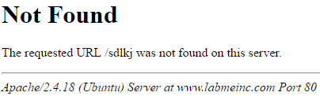
404 Not Found
Status code 404 is similar to DNS’s NXDOMAIN record
Occurs when a request is made for something that does not exist
Can occur due to typos but when monitored will discover:
Web crawlers
Vulnerability Scanners
Misconfigured websites
These generate lots of 404 messages

Slide 20
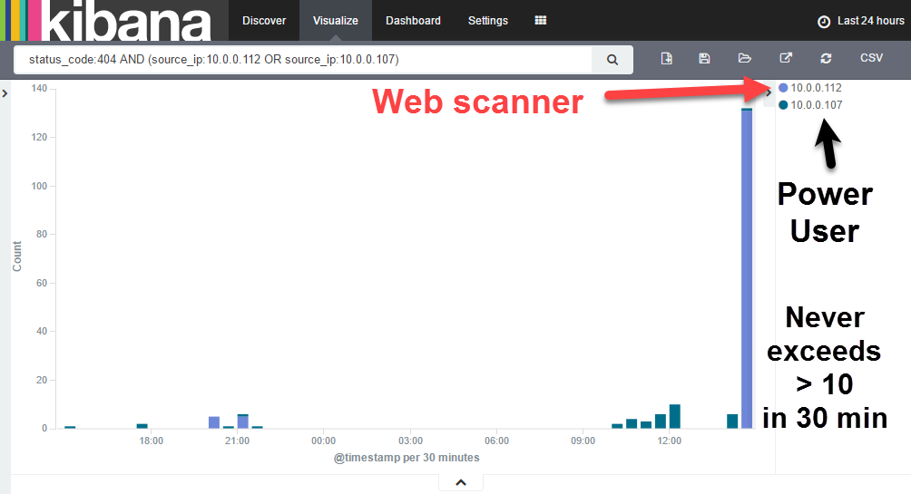
404 Monitoring

Slide 21
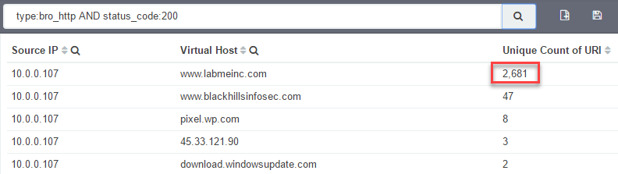
200 OK
Flip side of 404 is 200 which means the everything is OK
Too much of a good thing… is a bad thing
If someone is crawling or scanning a site there will be lots of unique URIs accessed with a status code of 200
Possible for a single request to be pure EVIL

Slide 22
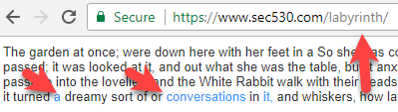
WebLabyrinth
WebLabyrinth is a PHP application that infinitely creates web pages
Design is to confuse or break automated scanners
Supports automated alerting
Normally would require set up on each server and require PHP
WAF can integrate WebLabyrinth into every web server
Works best with robots.txt
User-agent: *
Disallow: /labyrinth

Slide 23

Content Routing
WAF can dynamically route traffic among web servers
Capability intended for performance and load balancing
Can be used to add content to existing servers virtually
WAF is also capable of modifying requests/responses on-the-fly
Before
After
index.php
index.php
/admin
/admin
/labyrinth

Slide 24
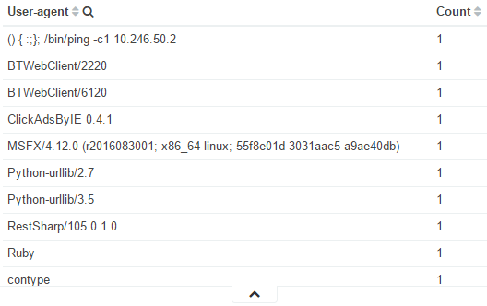
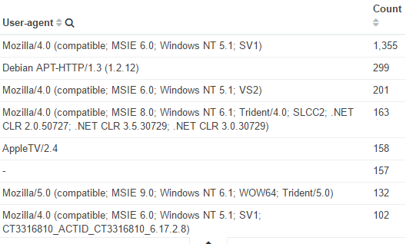
User-Agents
User agents are high value add with little work
Used to identify the client connecting to a web server
Web application pentest tools/scripts often self identify
vs.

Slide 25

Record Limits
Large data breaches are occurring more often
Commonly a web service with massive database stolen
DAM tracks record counts and can integrate with a SIEM
Bro can provide similar support (example - mysql.log)
Even if prevention controls do not exist using record limits
Alert on records pulled by source or app that exceed threshold
Threshold per single session
Threshold per aggregate sessions within a time frame
Potentially threshold alert per all sources per time frame

Slide 26
Database Logging
Most databases have logging disabled by default
May have generic service logs but missing logs on who did what
Built-in logging capabilities can be enabled
Change tracking - Record change logging
Common compliance criteria - success and failure events
Trigger logs - Custom logging events
Query logs - Records SQL statements
Each can cause performance issues
Plus logs are difficult to deal with and miss key information

Slide 27

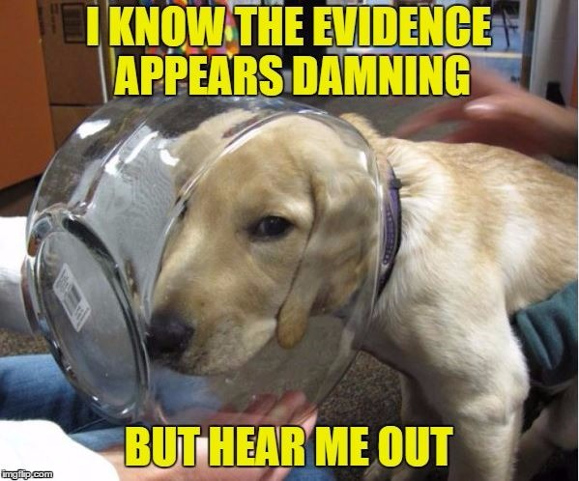
HoneyTokens Application Style
Adversaries pulling data from an application often get it from a database
Provides perfect capability for honeytoken detection
CC_database
Request for honeytoken = CAUGHT
customers_table
fake_table
- id: 1 name: DrizztDourden

Slide 28
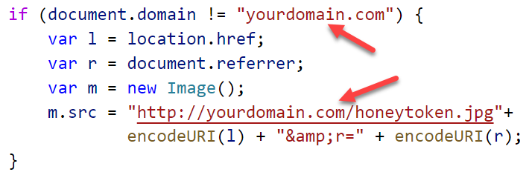
Go Phish
External facing web applications may be subject to cloning
Cloned site used to phish credentials and access
Simple JavaScript + logging can weaponize detection
http://yourdomain.com/honeytoken.jpg gets requested
But only if site is not accessed via yourdomain.com

Slide 29
Summary
Custom Applications are a difficult problem to solve
We can re-use old methods for a new purpose
Requires some standardization and process improvements
Database Activity monitoring can be used
http monitoring can be useful since most applications are now web-based
The SIEM is a business enabler

Slide 30
Tactical Detection Summit
Save the Date: December 4-11 Scottsdale, Arizona
sans.org/summit
SEC599 – Defeating Advanced Adversaries
SEC530 – Defensible Security Architecture
SEC555 – SIEM with Tactical Analytics
SEC511 – Continuous Monitoring & Security Operations
SIEM NetWars
SUMMIT
Dec. 4-5
TRAINING
Dec. 6-11
sans.org/summit
Notes:
Drag Picture and Send to Back

